Slide 1

LIFE EXPECTANCY (W.H.O)
PDS 10 MEMBERS:
FAITH MUTUA
EVANS TEYE MATEY
EUGENIA OWUSU-ANSAH
Notes:
Photo by Akil on Pexel

Slide 2
OUTLINE
-Introduction
1
-Analytical Approach/Algorithm Used
2
3
-Hypotheses and Research Questions
4
5
6
-Results and Findings
-Summary/Conclusion
-Recommendation/Implication

Slide 3
Introduction
An exploratory data analysis on the Life Expectancy dataset, on factors such as adult mortality, health care expenditure, alcohol consumption and immunization.

Slide 4
KEY METRICS
Import Libraries
Visualize Data
Replace Errors/
Drop Outliers
Winsorize Data
Analyze Clean Data

Slide 5
1. Should a country having a lower life expectancy value(<65) increase its healthcare expenditure in order to improve its average lifespan?
2. How does Infant and Adult mortality rates affect life expectancy?
HYPOTHESES
3. Does Life Expectancy have positive or negative relationship with drinking alcohol?
4. Do densely populated countries tend to have lower life expectancy?
5. What is the impact of Immunization coverage on life Expectancy?

Slide 6
Research Questions
1. Should a country having a lower life expectancy value (<65) increase its healthcare expenditure in order to improve its average lifespan?
2. How does adult mortality rate affect life expectancy?
3. Does life expectancy have a positive or negative relationship with drinking alcohol?
4. Do various predicting factors that has been chosen initially really affect life expectancy? What are the predicting variables actually affecting life expectancy?
5. What is the impact of immunization coverage on life expectancy?

Slide 7
Results and Findings
Research Solution 1
“Should a country having a lower life expectancy value (<65) increase its healthcare expenditure in order to improve its average lifespan?”

Slide 8
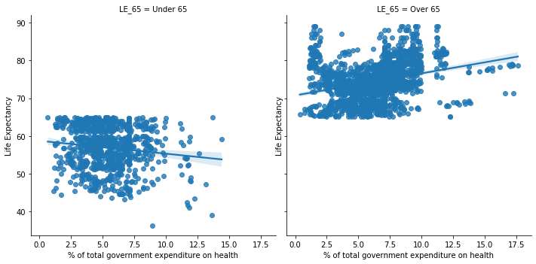
Cont’d
Figure 1: The impact of government expenditure on health correlated to Life Expectancy

Slide 9
Cont’d
Figure 2 : A developing country and developed country output on the impact of health expenditure on life Expectancy

Slide 10
Results and Findings
Research Solution 2
“How does adult mortality rate affect life expectancy?”

Slide 11
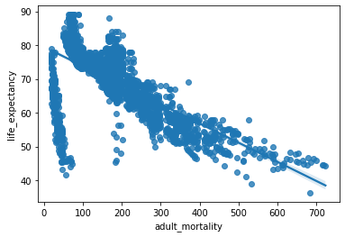
Cont’d
Figure 3: The effects of adult mortality on life expectancy per 1000 population

Slide 12
Results and Findings
Research Solution 3
“Does life expectancy have a positive or negative relationship with drinking alcohol?”

Slide 13
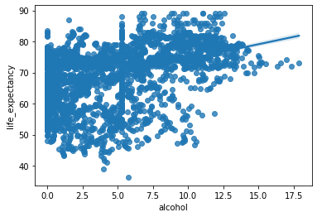
Cont’d
Figure 4: The impact of Alcohol Consumption on Life Expectancy

Slide 14
Results and Findings
Research Solution 4
“Do various predicting factors that has been chosen initially really effect life expectancy? What are the predicting variables actually affecting life expectancy?”

Slide 15
Cont’d
Life Expectancy = 0.9999999999999998),
Adult Mortality = -0.6783825597940726),
Infant Deaths, -0.13325091527669333),
Alcohol', 0.3929343679746082),
Percentage expenditure', 0.3815426339299435),
Hepatitis b', 0.22338184963625946)]
The results show that initial factors chosen has effects on life expectancy, there are both positive and negative correlations between these factors and our target variable Life expectancy.

Slide 16
Results and Findings
Research Solution 5
“What is the impact of immunization coverage on life expectancy?”

Slide 17
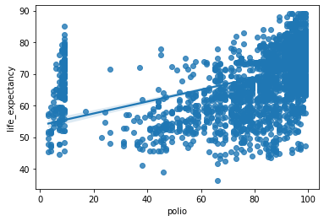
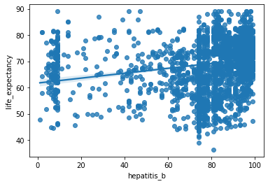
Cont’d
Figure 5: The impact of polio immunization on Life expectancy
Figure 6: The impact of hepatitis b immunization on life expectancy

Slide 18
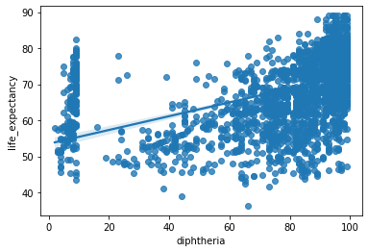
Cont’d
Figure 7: The impact of diphtheria on life expectancy

Slide 19

Recommendation/Implication
3. Several predicting factors such as hepatitis b, life expectancy, adult mortality, infant deaths, percentage expenditure and health expenditure actually have an influence on life expectancy.
5. Free or affordable vaccinations and immunization program be made available especially in developing countries.
2.Improve maternal healthcare and general health practices.
1. Increase in health care expenditure of developing countries.
4.Countries that had high level of alcohol consumption with high levels of life expectancy rates could have other influencing factors such better health facilities and social conditions influencing their life expectancy
Notes:
Photo by Christian Perner on Unsplash

Slide 20
Conclusion
In summary our group, PDS10 worked on the Life Expectancy Data using Python for data science tools such as NumPy, Pandas and matplotlib. We started with data cleaning of the dataset down to 12 variables to describe the target variable: life expectancy. It started with detecting and dealing with missing values and outliers. We converted inexplicit missing to explicit data values through the imputation method based on the means of countries.
Once the missing values were found we dealt with the outliers, we did this by using the standard box and whisker plots, each values data was winsorized on a one by one technique to remove outliers. Once all these were done data exploration on the clean data begun.
We used Bivariate analysis to understand the relationship between our dependent variable with other factors and variables. The correlation matrix in conjunction with the heatmap visual from seaborn library was used. We found out that factors such as adult mortality, government expenditure on health, immunizations, alcohol consumptions had correlations with our target variable (Life Expectancy). Our implication and recommendations centered on the impact on developing countries.
We also recommend further research into the specifiers of the factors should be done, because breaking the research into individual countries will give a clearer picture.

Slide 21
THANK YOU

